Slide 1
Section 8.6: Alternating Series
-

Slide 2
An Alternating Series is of the form
or
(with a_{k} >0)

Slide 4
Alternating Series test
If is an alternating series,
is a decreasing sequence, and
Then converges

Slide 5
Converges by the Alternating Series Test
Diverges by the
Divergence Test
Converges by the
Alternating Series Test

Slide 6
Definition
converges absolutely
if converges
If converges , but not absolutely,
then it converges conditionally.

Slide 7
Converges absolutely
Converges conditionally

Slide 8
So converges
by Direct Comparison Test
Thus Converges Absolutely

Slide 9
Generalized Ratio Test
Recall the Ratio test required
but we could just check
and see if converges absolutely.

Slide 10
Error Estimates
Notice if satisfies the Alternating Series Test,
then it is a “1 step forward, half step back” kind of sum.

Slide 11
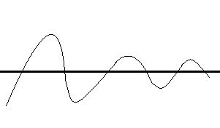
One term pushes sum up above the limit,
the next pushes it below the limit..
So the difference between the partial sum and the true sum is less than the next term!

Slide 13
Rearranging terms
Its probably not too surprising that you can rearrange the terms
in an absolutely convergent series and still get the same sum,
but a conditionally convergent sum can be rearranged
to sum to anything you want.

Slide 14
Proof:
Pick any number L you’d like the new series to converge to.
The positive terms and negative terms both converge to 0 as sequences,
but the sum of each diverges.
Re-arrange them from largest to smallest.

Slide 15
Add up positive terms until you get past L.
Subtract negative pieces until you get below L.
Repeat…
Since terms→ 0 the “over shooting”→ 0

